Slide 1
PART THREE
System Explanation
Notes:
Hello I’m Leo, next I will introduce the part of System Explanation, which is mainly written by me and zhuzhu. This part mainly introduces the overall goals, functions and block diagram of the system.

Slide 2
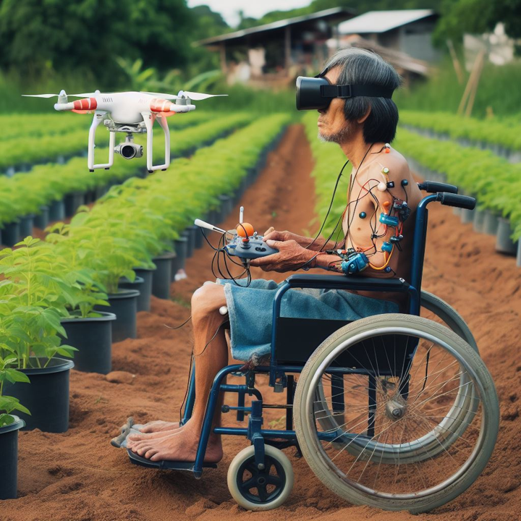
Aim of the System
01
Reducing Inequality
02
Promote Agricultural Production Efficiency
03
Protecting the health of people with disabilities
Source: Bing AI
Notes:
The overall goal of this system is to first solve the employment problem of people with disabilities in the third world to reduce inequality, increase food production by controlling drone irrigation to reduce hunger, and provide better health testing and higher-end employment for people with disabilities. post.

Slide 3
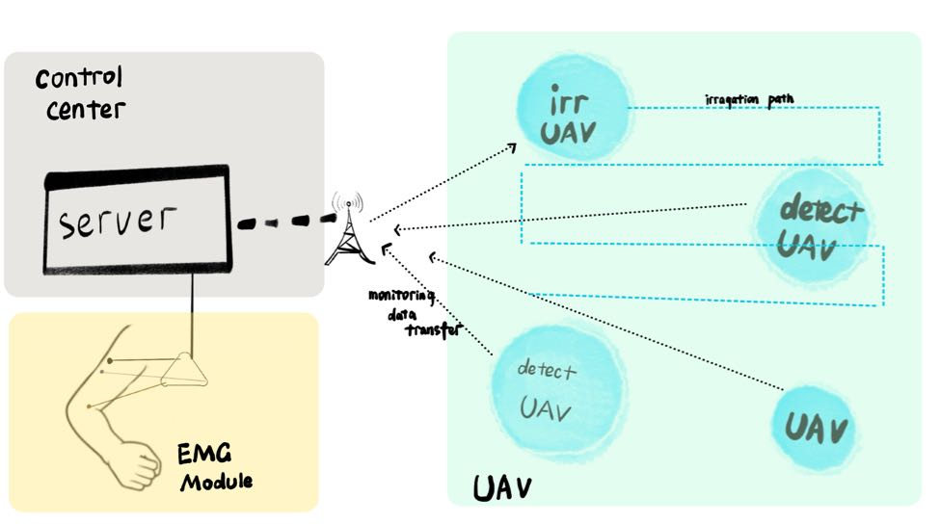
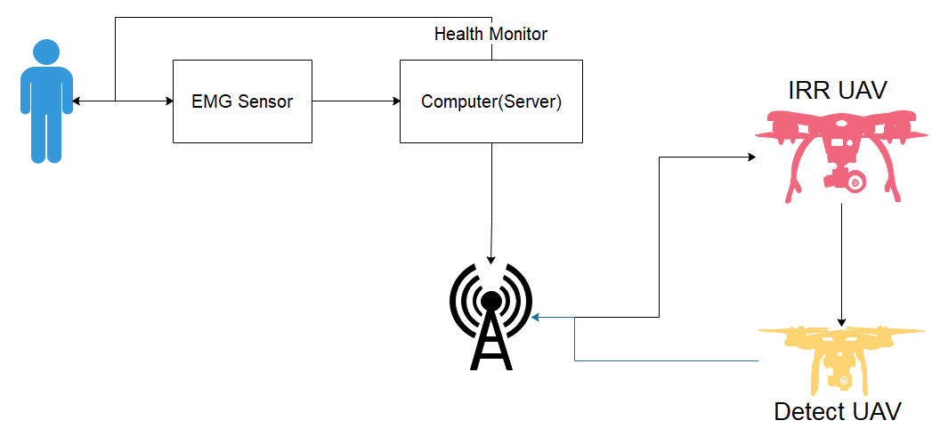
Function and Block Diagram of the System
Function of the System
Overall Block Diagram
Notes:
"Alright, let me break down What’s the function of the System. So, we've got these muscle sensors picking up signals, right? They shoot those signals over to our server. Once the server does its thing—processing and all—it sends commands to our UAVs.Now, we've got two types of these flying buddies: the 'Detect UAV' and the 'Irrigation UAV.' The Detect UAV scouts around, gathers data, and sends it back to the server. Then, the server tells the Irrigation UAV to start watering based on that data.
According to the Overal Block Diagram: on one side, you've got the drone area, where all the action goes down. On the other, there's our central hub connected to the server. The muscle sensor sends signals to the server, which then directs the UAVs. Simple as that—signals in, commands out, and the job gets done."

Slide 4
PART FOUR
Function of Subsystem
Notes:
Next I will introduce the part of Function of Subsystem, which is mainly written by me and zhuzhu. This part mainly introduces the subsystem like the EMG system and UAV system.

Slide 5
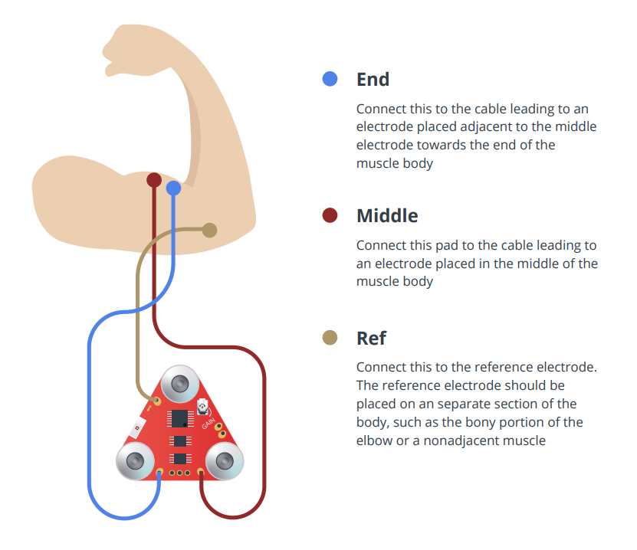
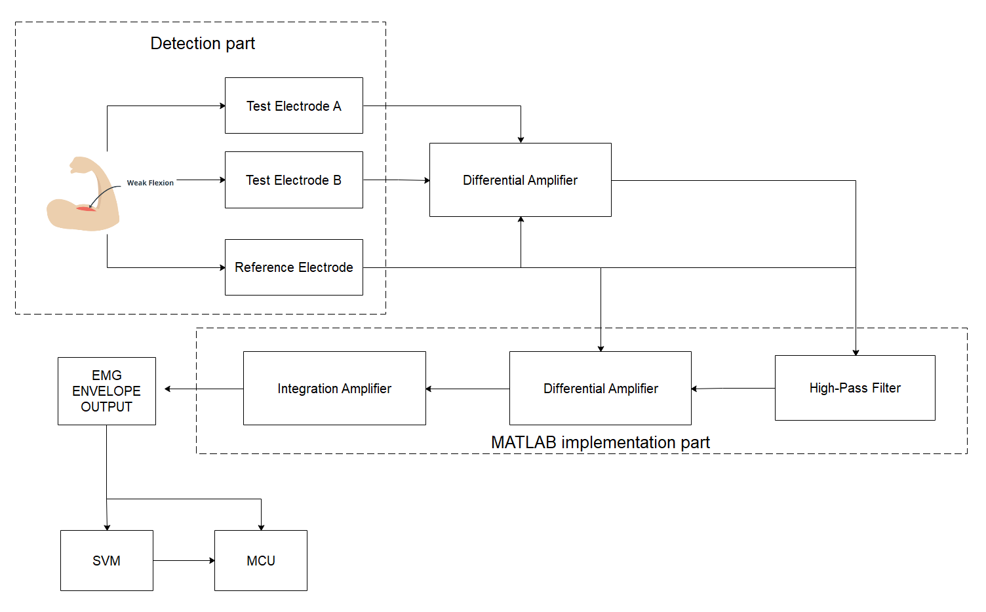
Function of Subsystem
PART FOUR
Simulation of EMG sensors
Block diagram of EMG subsystem
Source: MyoWare 2.0 QuickStartGuide
Notes:
The first subsystem of the system is the EMG system. We first simulate the connection of the EMG sensor: the EMG sensor has three electrodes, two are test electrodes and one is a reference electrode. After they are connected to the corresponding positions, we will use A differential amplifier removes noise and focuses only on differences in muscle signals. Once we get this signal, we will enter MATLAB. In order to facilitate the description of the process. We will replace MATLAB with hardware here. First, a high-pass filter is used on the differentially amplified EMG signal to remove all low-frequency signals and DC offsets. Next, a component called a lead-lag rectifier is used, which converts all signals into absolute values. Finally, the difference between the rectified signal and the reference electrode signal is amplified through an amplifier, and finally the envelope myoelectric output is obtained through the integrating amplifier output.
After obtaining the EMG envelope signal, we still have an unsolved problem: how to identify the information conveyed by the electromyographic signal? In order to solve this problem, our solution is to preprocess first and then use neural network related algorithms to identify the signal.

Slide 6
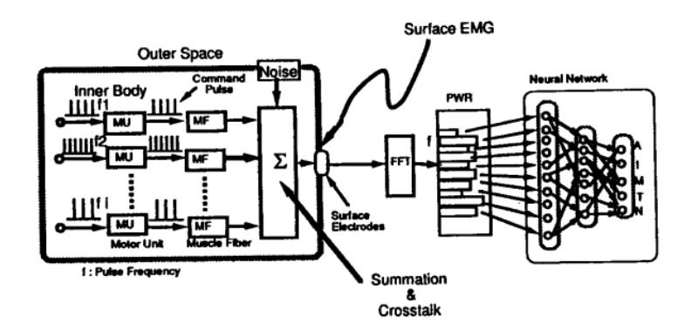
Function of Subsystem
Preprocessing and feature extraction of EMG signals
Improve signal-to-noise ratio
FFT can help identify and filter out noise
Recognize muscle fatigue
FFT helps diagnose specific neuromuscular diseases
Fast and efficient
FFT is a very efficient algorithm that can quickly convert time domain signals to frequency domain.
Source: Hiraiwa, Akira, Katsunori Shimohara, and Yukio Tokunaga. "EMG pattern analysis and classification by neural network." Conference proceedings., IEEE international conference on systems, man and cybernetics. IEEE, 1989
Notes:
Before that, we must first solve the preprocessing of the EMG signal. In order to be able to deal with the problem in the frequency domain, we prefer to use FFT to preprocess the EMG signal. There are many benefits to using FFT, including helping to analyze and filter out noise, and also analyzing the frequency characteristics of muscle activity to identify muscle fatigue, as well as the fast and effective characteristics we are all familiar with.

Slide 7
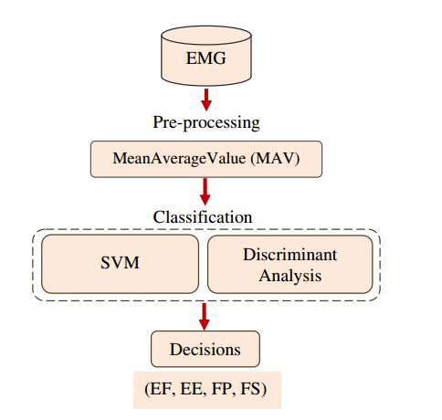
Function of Subsystem
Comparison between SVM and neural network
添加标题内容
Neural Network
SVM
Source: Alkan, Ahmet, and Mücahid Günay. "Identification of EMG signals using discriminant analysis and SVM classifier." Expert systems with Applications 39.1 (2012): 44-47.
Notes:
After solving the signal preprocessing, in order to realize the recognition of different muscle parts, we must identify the muscle patterns of different parts in a targeted manner. Naturally, we will think of using neural networks to solve the signal recognition problem. However, in the traditional sense The neural network algorithm on the Internet requires a large number of data sets. After comparison, we chose the Support vector machine (SVM), which can be implemented with only a small number of data sets, to identify myoelectric signals.

